Slide 2
Welcome / Logistics
Ioannis Liabotis
Iliaboti <at> grnet <dot> gr

Slide 3
PRACE Autumn School in HPC Programming Techniques - Athens, Greece
Organized by PRACE AISBL, PRACE-3IP Project and GRNET
25-28 November 2014, Athens (Greece)
Place OTE Academy - Education center of the Greek Telecommunications Organization, co located with its research center

Slide 4
Schedule Overview (1)
Day 1 – Tuesday (half day)
About PRACE, Towards Exascale, Access to PRACE Resources, Access to the Hands on sessios resources
Day 2 – Wednesday (full day)
MPI (including Hands on sessions)
OpenMP (including hands on sessions)

Slide 5
Schedule Overview (2)
Day 3 – Thursday (full day)
Hybrid programming (including hands on)
Hybrid programming case study
Usage of Scientific Libraries (including hands on)
Profiling (including hands on)
Social Event

Slide 6
Schedule Overview (3)
Day 4 Friday (half day)
Optimization and benchmarking

Slide 7
Trainers
Dr. Costas Bekas - Cognitive Computing Group at IBM Research – Zurich
Dr. Alan O’ Cais, Application Support - Juelich Supercomputing Centre
Mr Paschalis Korosoglou, technical coordinator of the Scientific Computing Office - Aristotle University of Thessaloniki
Dr. Dimitris Dellis, Senior Application Support, GRNET
Mr. Nikolaos Tryfonidis is a PhD Candidate in the Aristotle University of Thessaloniki
Mr. Ioannis Liabotis (Project Manager, GRNET)
Kyriakos Ginis, Senior System Administrator, GRNET

Slide 8
Social Event (1)
Visit to Acropolis Museum
Thursday at 19:00
Declare your participation today by signing the paper to be circulated

Slide 10
Social Event (2)
Dinner at Fish and Butcher Shop
Time: 20:15
Declare your participation today by signing the paper to be circulated (bus will take you from Museum to Butcher shop)

Slide 11
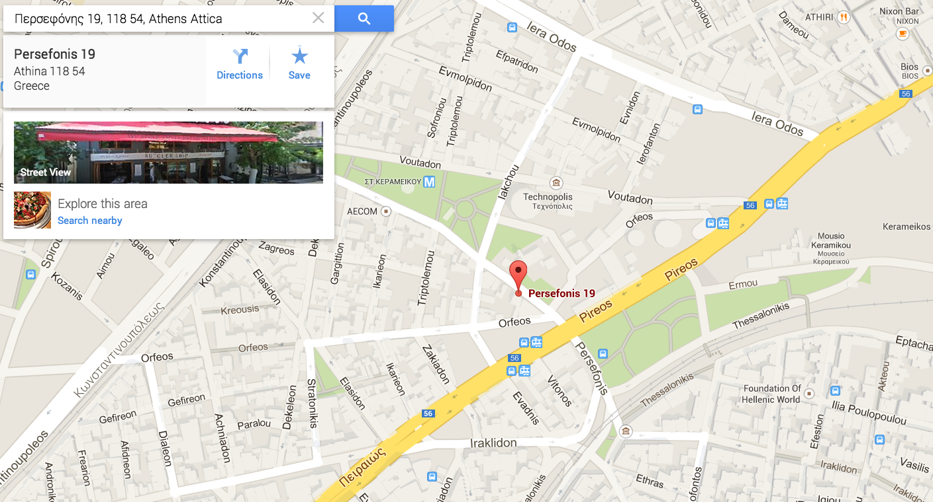

Slide 12
Bus timetable
See the web site
http://events.prace-ri.eu/conferenceDisplay.py?ovw=True&confId=328

Slide 13
Lunch served here between 12:30 and 13:30
On Friday only sandwiches to allow people to leave early if needed.

Slide 14
Coffee Breaks
Lecturers are free to organize coffee breaks as they this its appropriate.
The idea is to have many small sessions with very short (10 min) breaks. Like at school

Slide 15
Live Broadcast / Video
The event is video recorded (the lecturers) and also broadcasted (pilot service) via http://diavlos.grnet.gr/event/e431
Lecturers are encouraged to stay close to the desk

Slide 16
Hands on
Access to hands on system (in Cyprus) will be tested today
Students should be working in pairs

Slide 17
Thank you
Questions ?

