Slide 2
How to Get Access to PRACE resources
Ioannis Liabotis
Iliaboti <at> grnet <dot> gr

Slide 3
What is PRACE?
A sustainable European HPC Research infrastructure (PRACE-RI)
a single European entity for researchers to gain access to European HPC resources
Offering access to HPC resources through a single and fair pan-European peer review process

Slide 4
Which are the HPC resources available through PRACE?

Slide 5
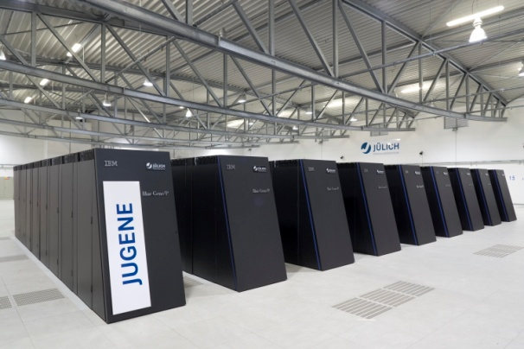
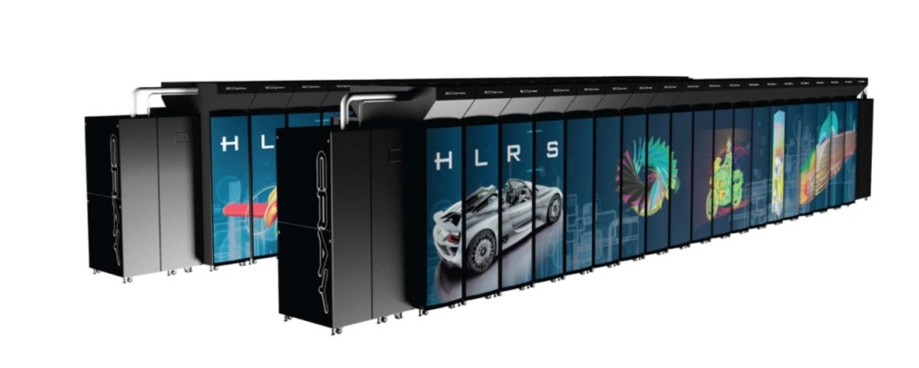
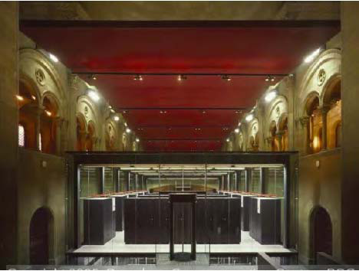
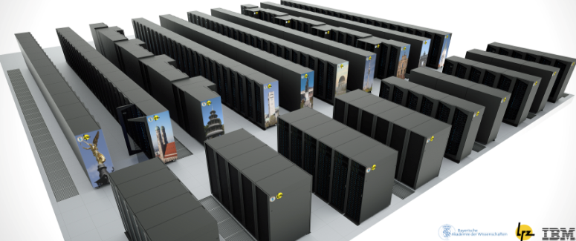
Tier-0 Petaflop-Capability in PRACE
BlueGene/P 5.87 Petaflop/s PRACE@GCS@Jülich
Bull Cluster Curie 1.8 Petaflop/s
PRACE@GENCI@CEA
BlueGene/Q 1 Petaflop/s PRACE@CINECA
CRAY HORNET 4 Petaflop/s PRACE@GCS@HLRS
IBM SuperMUC 3 Petaflop/s PRACE@GCS@LRZ
MareNostrum 1 Petaflop/s PRACE@BSC
5
Notes:
5

Slide 6
How can researchers access the HPC resources available via PRACE?

Slide 7
2 types of resource allocations
Preparatory Access (for development and scaling of codes) :
permanently opens with regular quarterly cut-off dates (March-June-September-Dec)
Intended to prepare proposals for Project Access
For testing, developing improving and optimizing codes with or without support
Not for production runs
3 types of categories:
testing scalability: Type A, allocation for 2 months
Code development or optimisation:
Type B, allocation for 6 months
Type C, allocation for 6 months, including support
fixed amount of resources for awarded proposals from 50 to 250k CPU hours, depending on the system

Slide 8
Technical review only
Evaluation process lasts for 6 working weeks
Eligibility check + applicants corrections ( 2 days after the cut-off date)
Technical review
Evaluation check and BoD decision
HM information on awarded proposals and letters sent to applicants (approx 30 days after cut off)
Awarded applicant contacted by technical team to arrange setting up an account
Start date of awarded projects aprox. 45 days after the cut-off date
Please refer to the terms of reference for the exact conditions of the call
http://www.prace-ri.eu/IMG/pdf/PRACE_preparatory_access_terms_of_reference-2014-october-up-dated.pdf

Slide 9
2. Regular Access
12 months awarded period
resources awarded on duly justify requests, above 5Mio CPU hours
Intended for senior researchers and research groups including multi-national research groups
Technical and Scientific peer review

Slide 10
Best science supported on the highest level through a fair Peer Review Process
Regular calls for proposals publish on PRACE web site :
2 calls a year
February – September
Call opens in February > Access is provided starting September
Call opens in September > Access is provided starting March
http://www.prace-ri.eu/Call-Announcements

Slide 11
Time schedule for regular calls: About 21 working weeks from call opening to publication of results
Regular calls are open at least for 6 weeks
Evaluation process lasts about 15 weeks
Eligibility check + applicants reply
Technical evaluation - Designation of experts
Scientific evaluation
3 experts by proposals
Experts chosen by AC
3 weeks for evaluating a proposal
Applicants Right to Reply, 1 week
Prioritisation panel, BoD approval, communication to users, creation of accounts

Slide 12
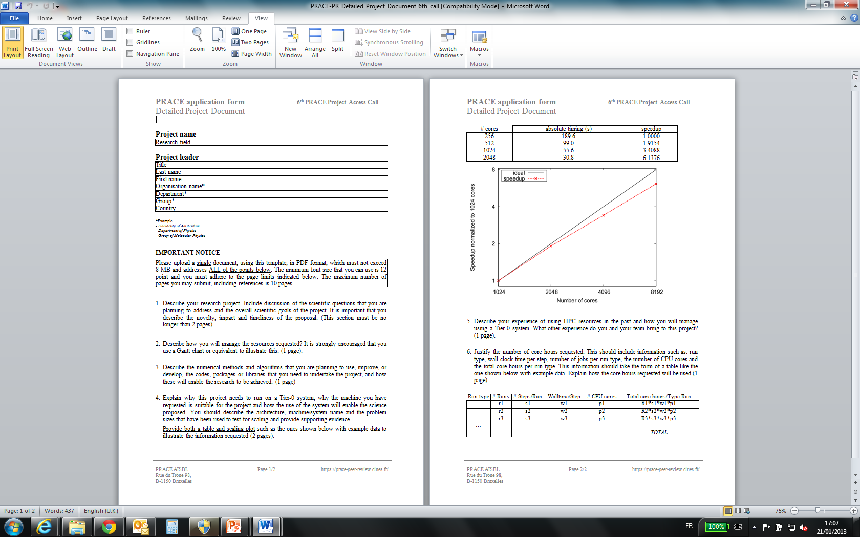
Detailed PROJECT description form (in Adobe Acrobat format, respect the template)

Slide 13
Eligibility
Proposals from researchers in academia are eligible if:
the project leader is a senior researcher employed in a research organisation.
The employment contract of the project leader is valid at least 3 months after the end of the allocation period.
Proposals from researchers in industry are eligible if:
The company has its head office or substantial R&D activity in Europe.
The employment contract of the project leader is valid at least 3 months after the end of the allocation period.
Access is devoted solely for open R&D research purposes.
Proposals asking for resources on a single machine or on multiple machines are allowed.
Please note that a proposal asking for resources on multiple machines has to justify the need to access several machines. The proposal will be awarded or rejected in its totality (no subpart of the proposal will be awarded).

Slide 14
Terms of Access
REPORTING: providing a final report on the results obtained* is a mandatory condition to access PRACE resources
No EXTENSION : exception possible in time only & only in case of unforeseen technical issues
ACKNOWLEDGEMENT: applicants must acknowledge PRACE in all publications that describe results obtained using PRACE resources, using the text specified in the "Guide for Applicants to Tier-0 Resources” section 4.2.
DISSEMINATION: applicants allow PRACE to publish the final report of the project (please check specific conditions), and should provide some material for additional dissemination activities (slides, pictures, reference of publications with work executed in PRACE systems).
Notes:
*confidentiality provision

Slide 15
Peer Review
Transparency
Fairness
No parallel assessment
Expert reviews
Confidentiality
Right to reply

Slide 16
Assessment Process
Technical Assessment
Need to use PRACE resources
Software availability
Feasibility
Scientific Assessment
Scientific excellence, Novelty and transformative qualities, Relevance to the call, Methodology, Dissemination, Management.

Slide 17
Other types of access
Multi Year Access (two year access with intermediate assessment)
Industrial Access (parts of the normal access, companies eligible for open research)
SHAPE Programme (support to SME for the use of HPC)

Slide 18
Further reading @
www.prace-ri.eu/How-to-apply
Terms of reference of Open calls @
www.prace-ri.eu/Call-Announcements
Not able to get the information on the web, further questions
peer-review@prace-ri.eu

