Slide 1
Hybrid MPI/OpenMP (Short discussion)
PRACE Autumn School
25-28 Nov 2014, OTE Academy
Athens

Slide 2
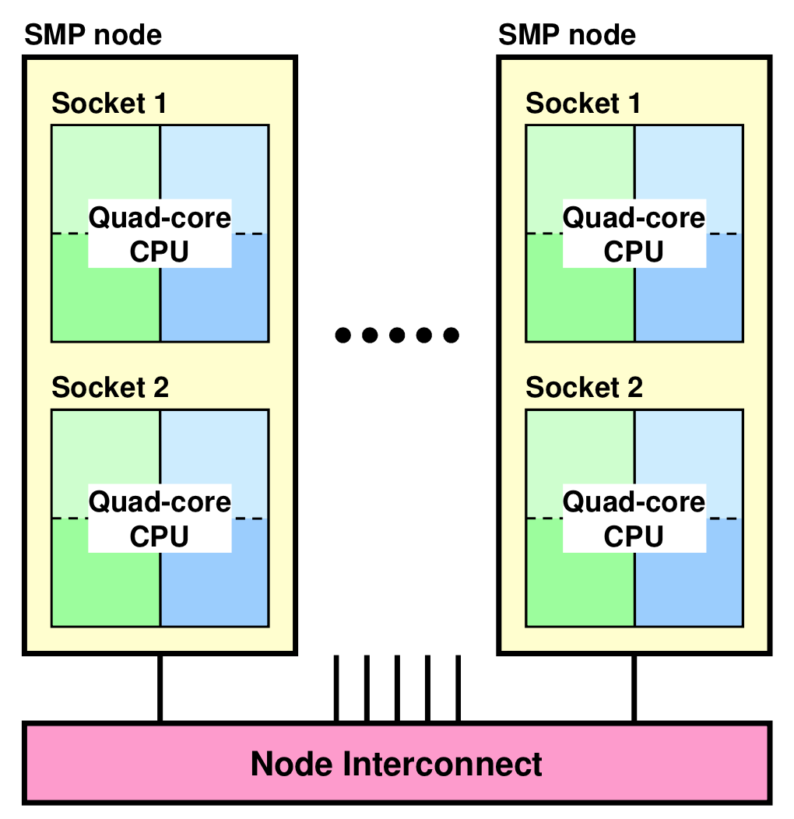

Slide 3
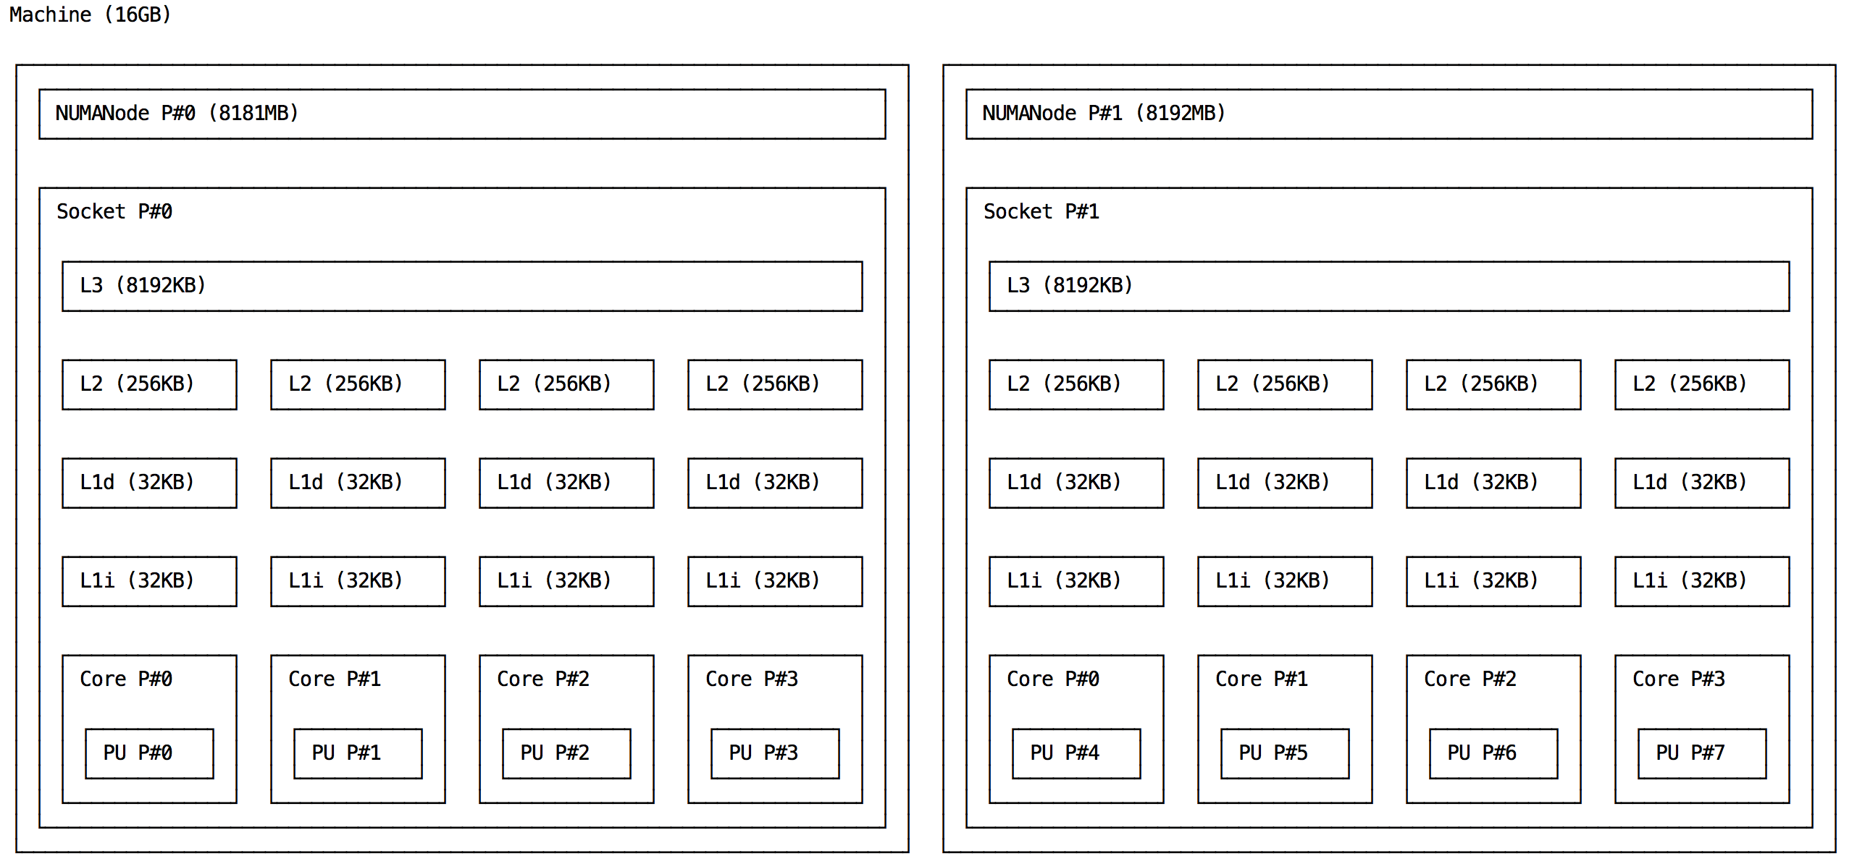

Slide 5
4-way multi-threaded

Slide 6
Threading and MPI
Initialization call | Description
MPI_Init | Each process will thread within OpenMP parallel regions. Threads are not aware of MPI environment. Safest choice.
MPI_THREAD_SINGLE | Only one thread will execute (i.e. no threading)
MPI_THREAD_FUNNELED | Only master thread will make MPI-calls. Threads are allowed. Also a safe and sane choice to make.
MPI_THREAD_SERIALIZED | Multiple threads may make MPI-calls, but only one at a time (i.e. like enforcing a critical clause upon MPI calls)
MPI_THREAD_MULTIPLE | All threads may make MPI calls from within OpenMP parallel regions

Slide 7
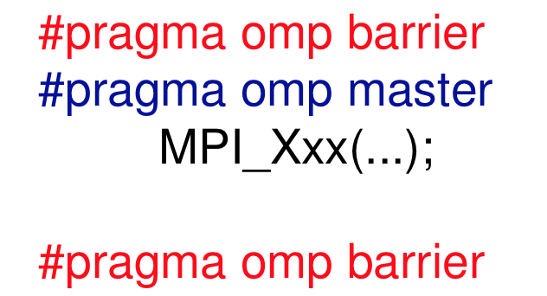
Synchronization becomes a mess...
In funneled mode
Ensure the master thread is making the MPI call
Insert barriers before and after placing the call to prevent race conditions
Barriers may induce cache flushes..

Slide 8
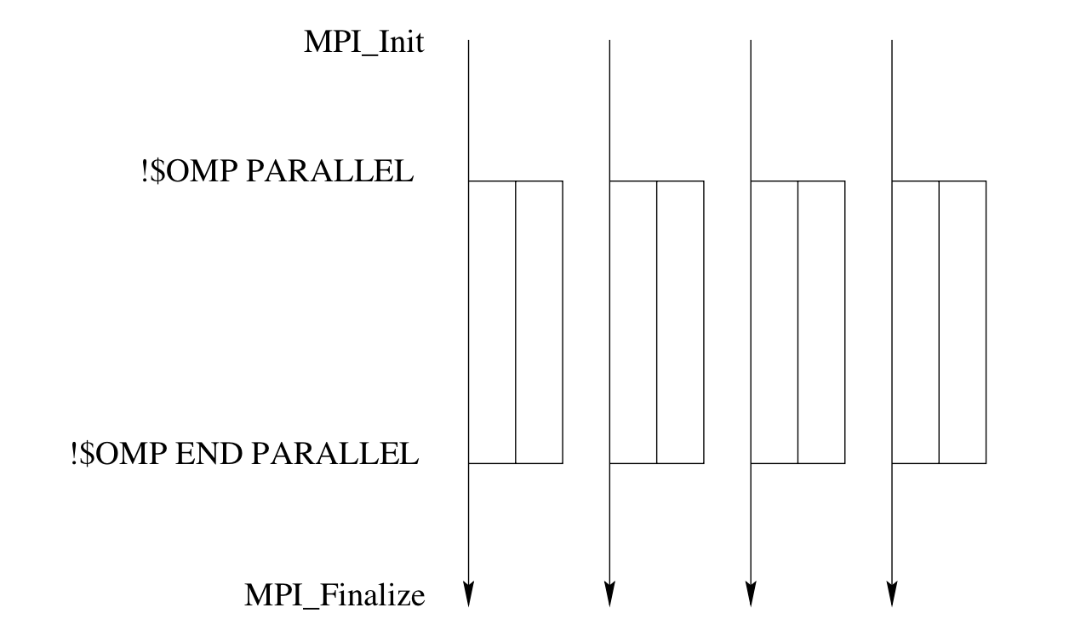
Execution flow

Slide 9
Pros and cons
Reduction of communications
Threading on modern archs is well supported
Additional synchronization needs may lead to poorer performance

Slide 10
Matrix vector multiplication
Row-wise approach (first MPI then Hybrid)
A
x
b
b
MPI_Allgather
all chunks into
one global array

